Slide 1
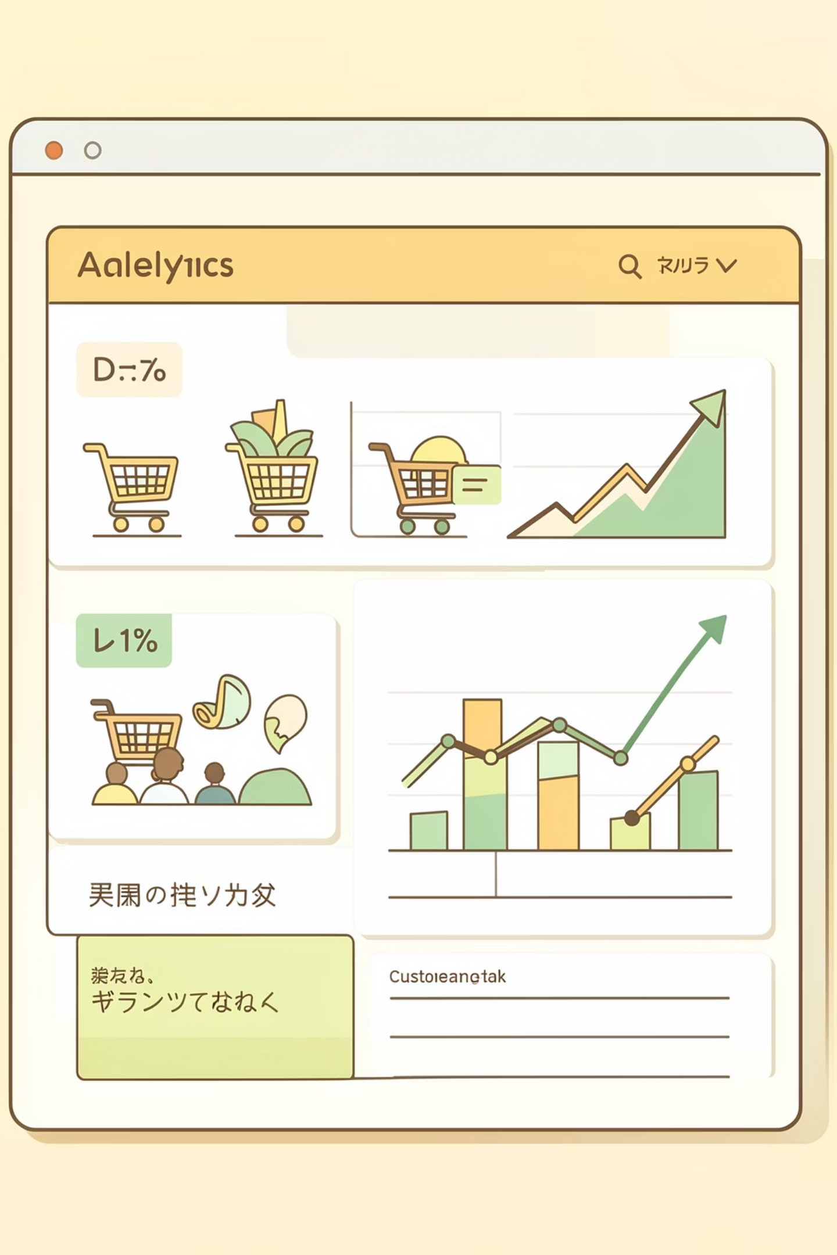
Customer Shopping Behavior Analysis
End-to-end analysis of retail transactions to understand customer interactions and drive business insights

Slide 2
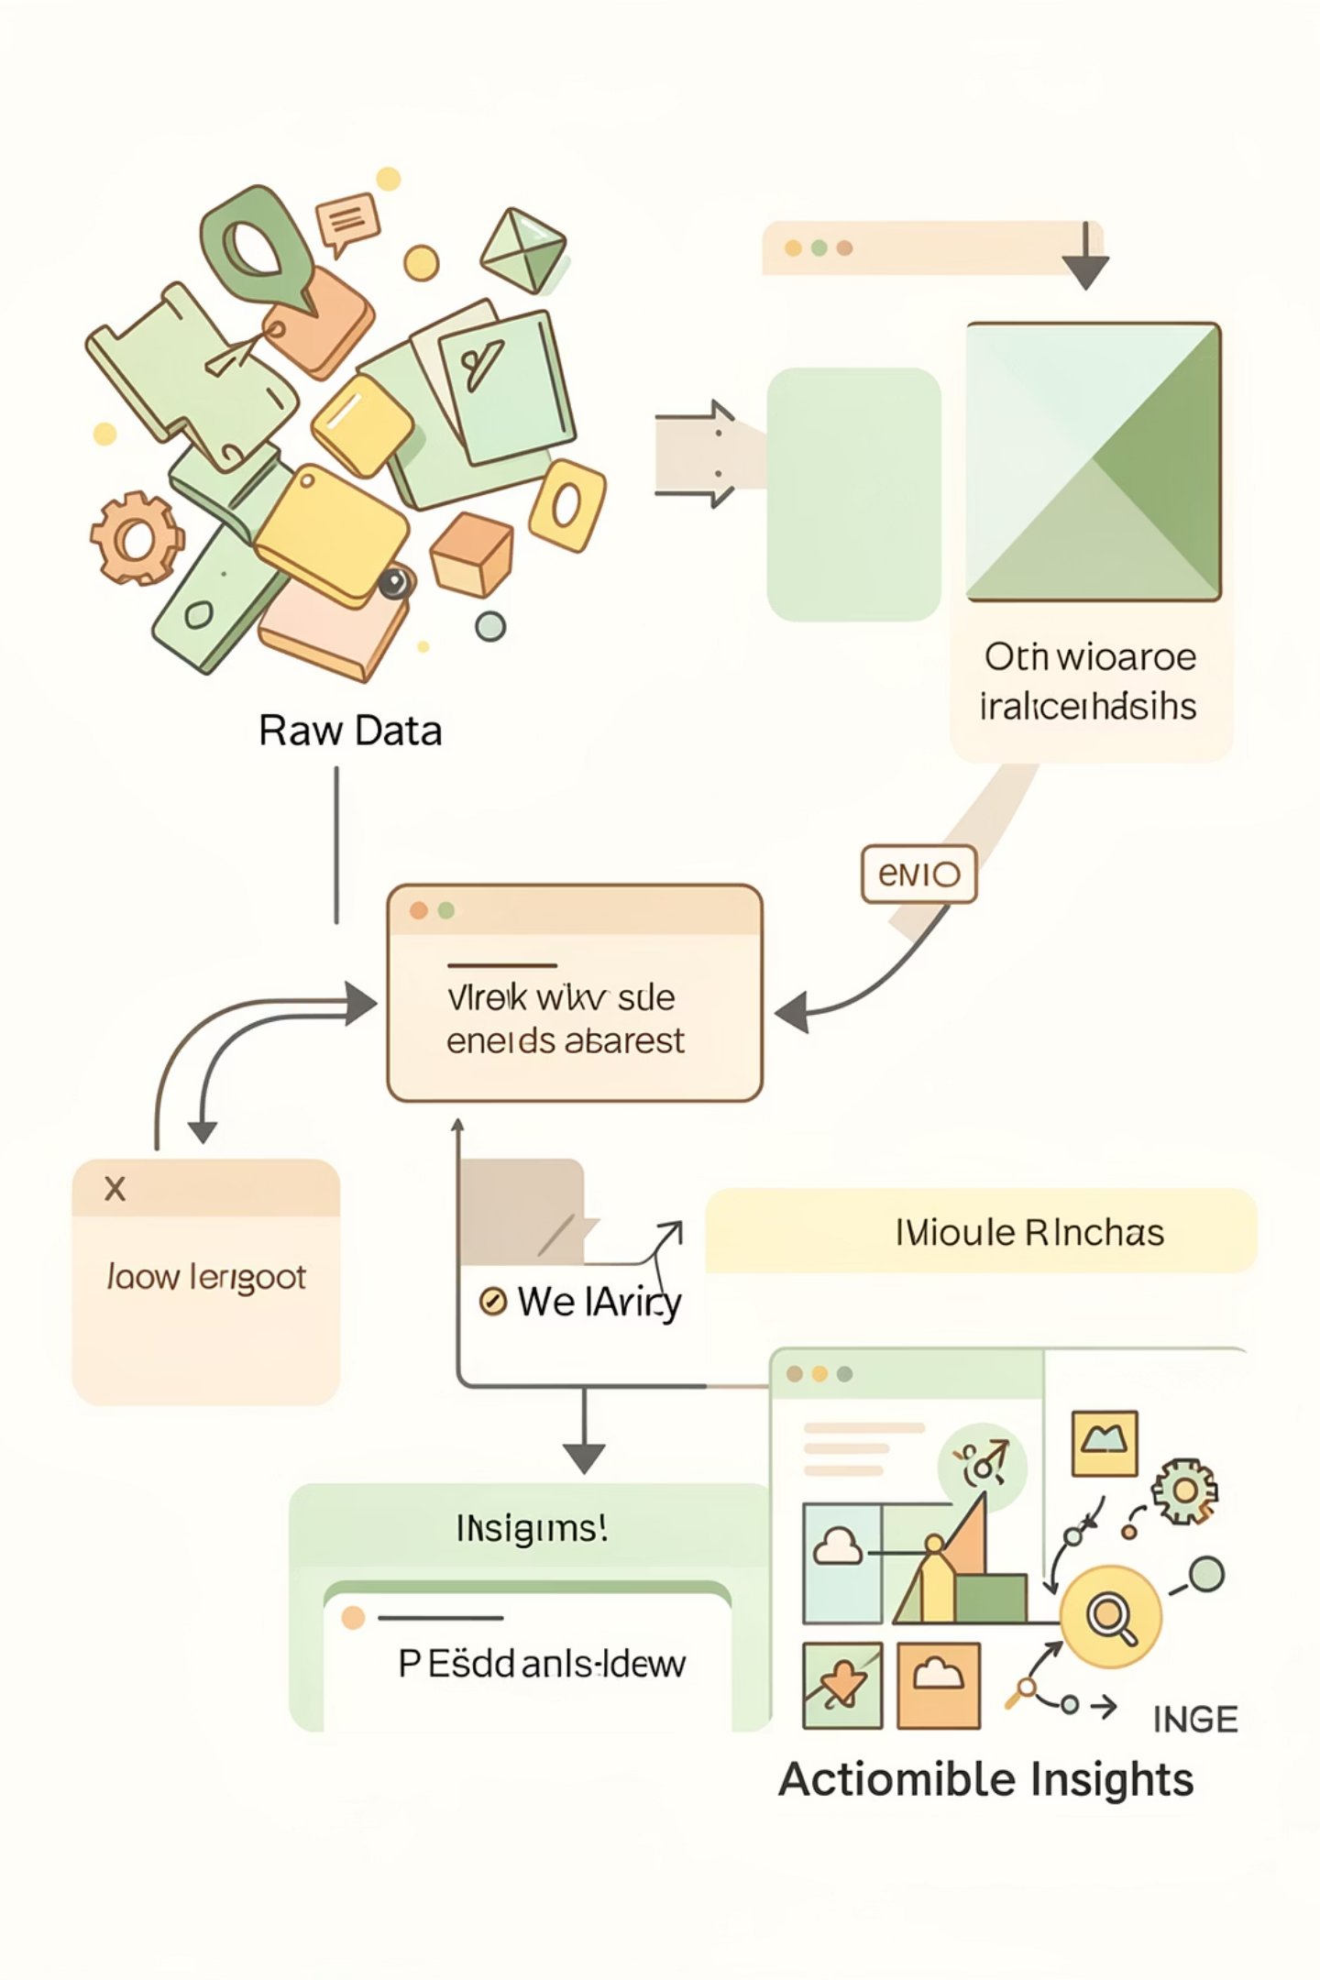



PROJECT SCOPE
From Raw Data to Actionable Insights
Data Preparation
Clean and process using Python & Pandas
SQL Analysis
Query patterns and behaviors
Visualization
Interactive Power BI dashboard

Slide 3
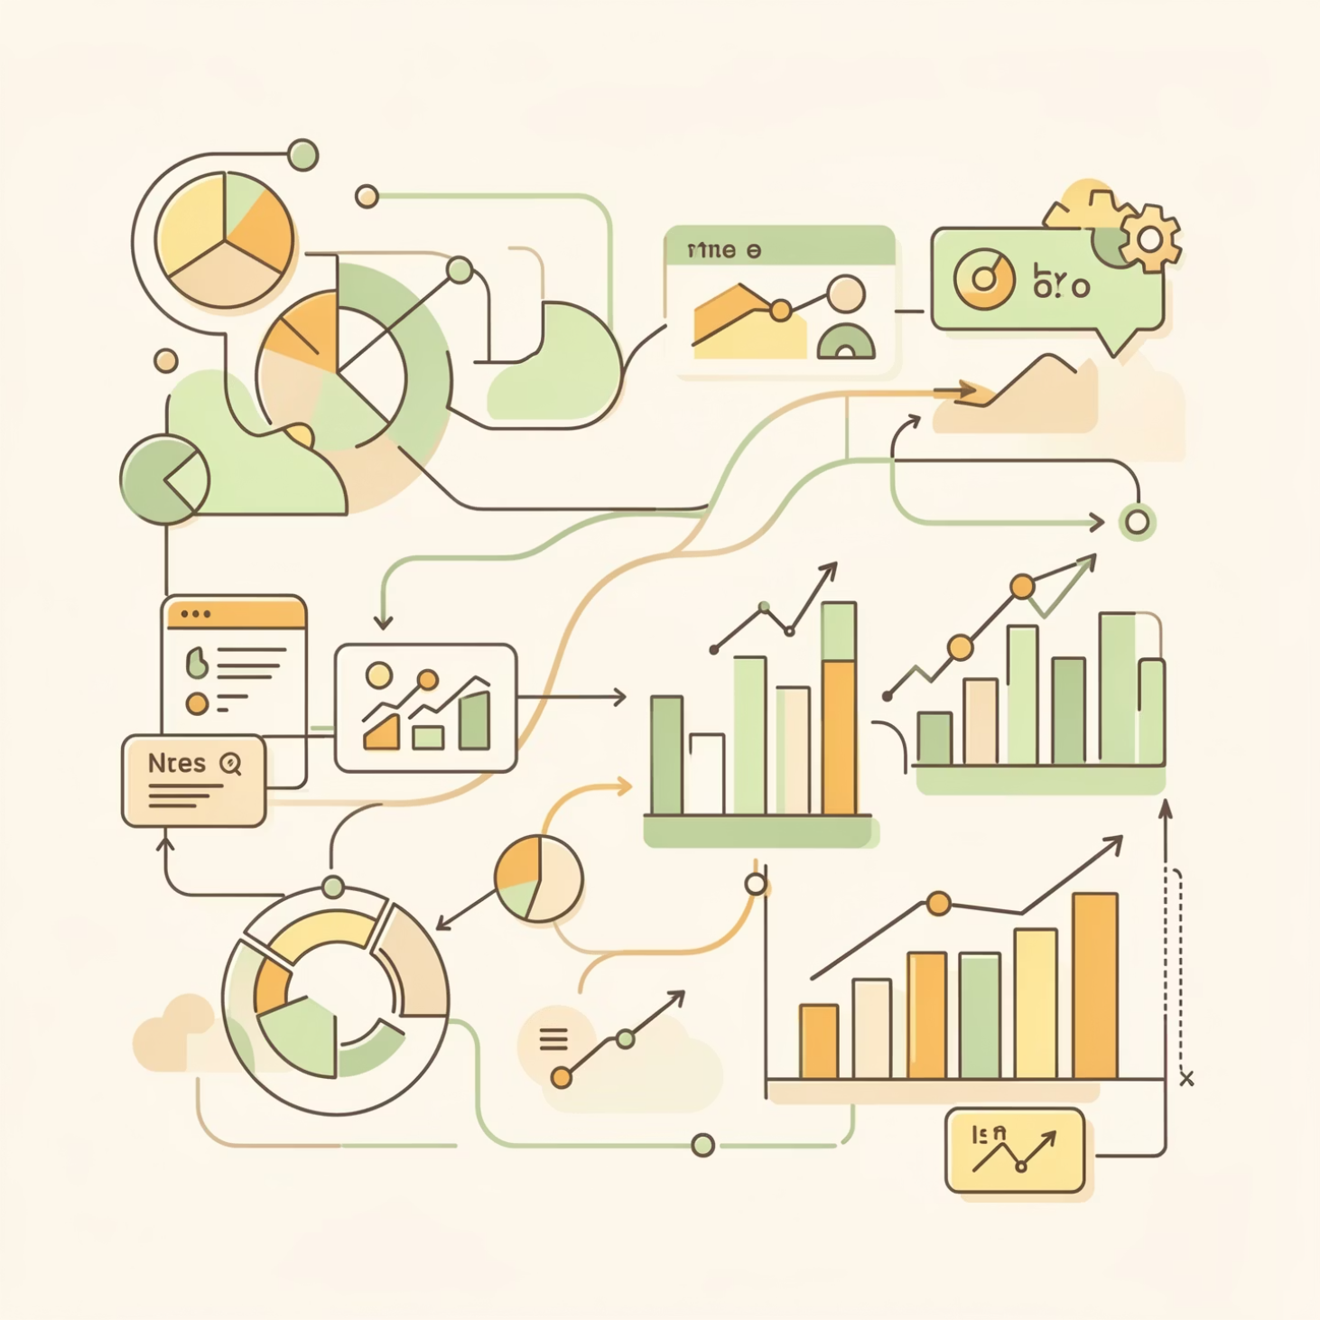
Dataset Overview
3.9K
18
Transactions
Features
Customer records analyzed
Data columns captured
Key Data Categories
Customer demographics: age, gender, location, subscription
Purchase details: items, categories, amounts, seasons
Behavior indicators: discounts, ratings, frequency, shipping

Slide 4

PYTHON & PANDAS
Data Preparation Process
Missing Data
Standardization
Feature Engineering
Imputed review ratings using category medians
Renamed columns to snake_case format
Created age groups and purchase frequency metrics
Data Cleanup
Removed redundant promo code column

Slide 5
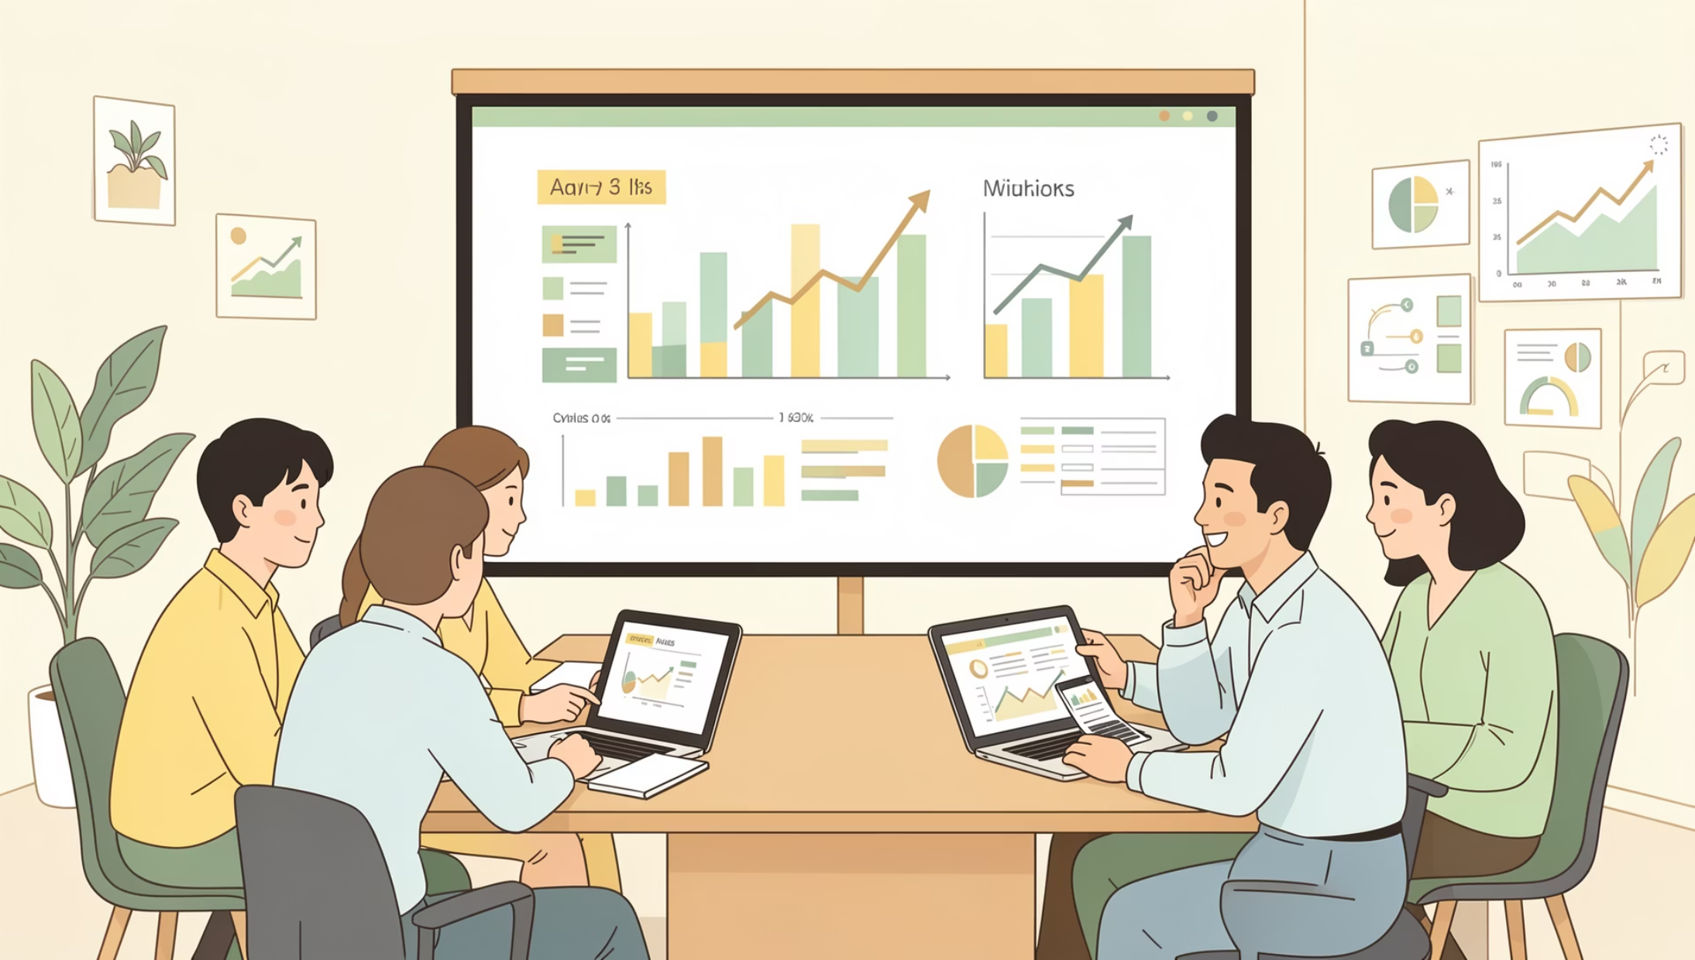
Key Customer Insights from SQL Analysis
Revenue by Gender
Male customers: $157K vs Female: $75K
Top-Rated Products
Gloves (3.86), Sandals (3.84), Boots (3.82)
Shipping Impact
Express shipping: $60.48 avg vs Standard: $58.46

Slide 6
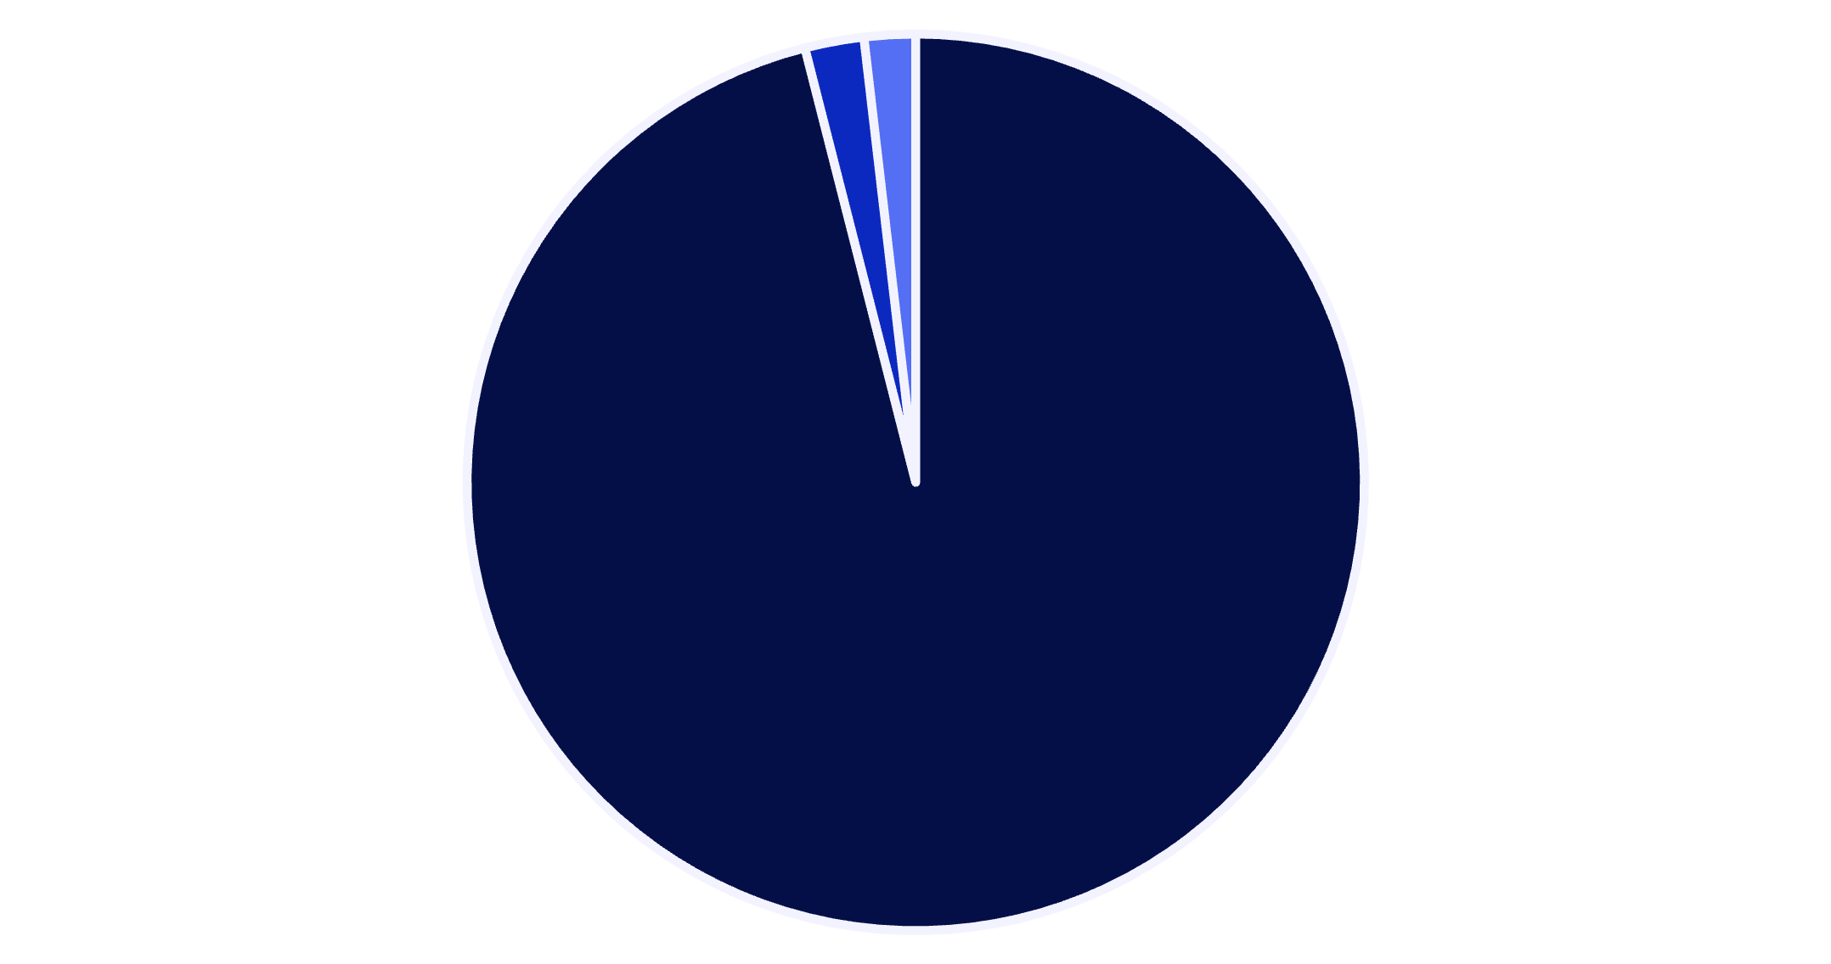
Customer Segmentation Breakdown
Loyalty Dominates
96% of customers classified as loyal based on purchase history
Focus on retention strategies to maintain this strong base while converting new customers faster
Loyal
New
Returning

Slide 7

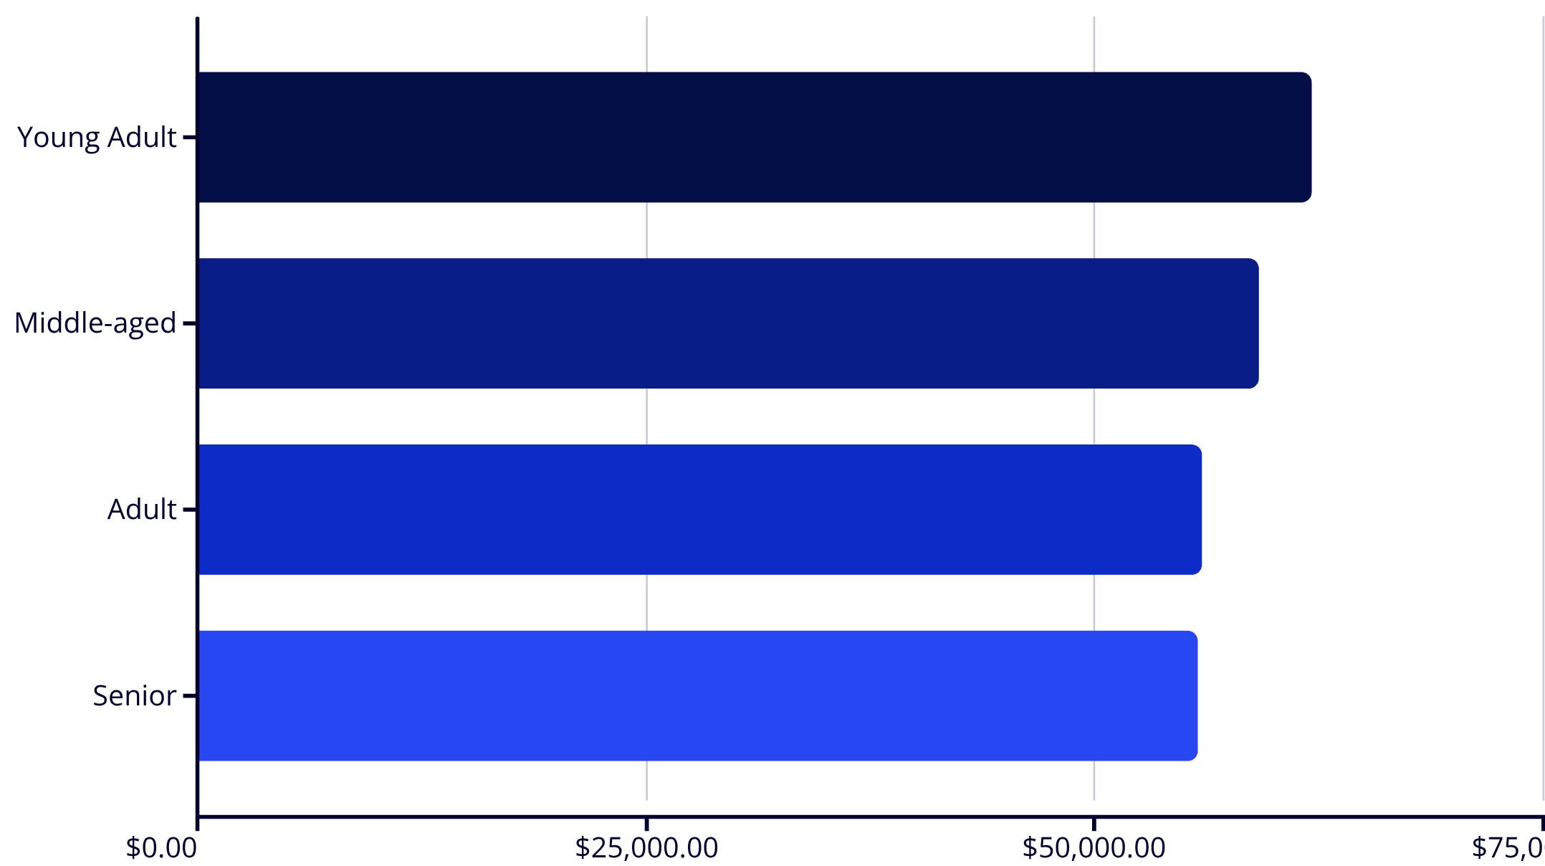
REVENUE ANALYSIS
Age Group Performance
Young adults drive highest revenue at $62K, followed closely by middle-aged customers at $59K
Relatively balanced distribution suggests broad market appeal across demographics

Slide 8
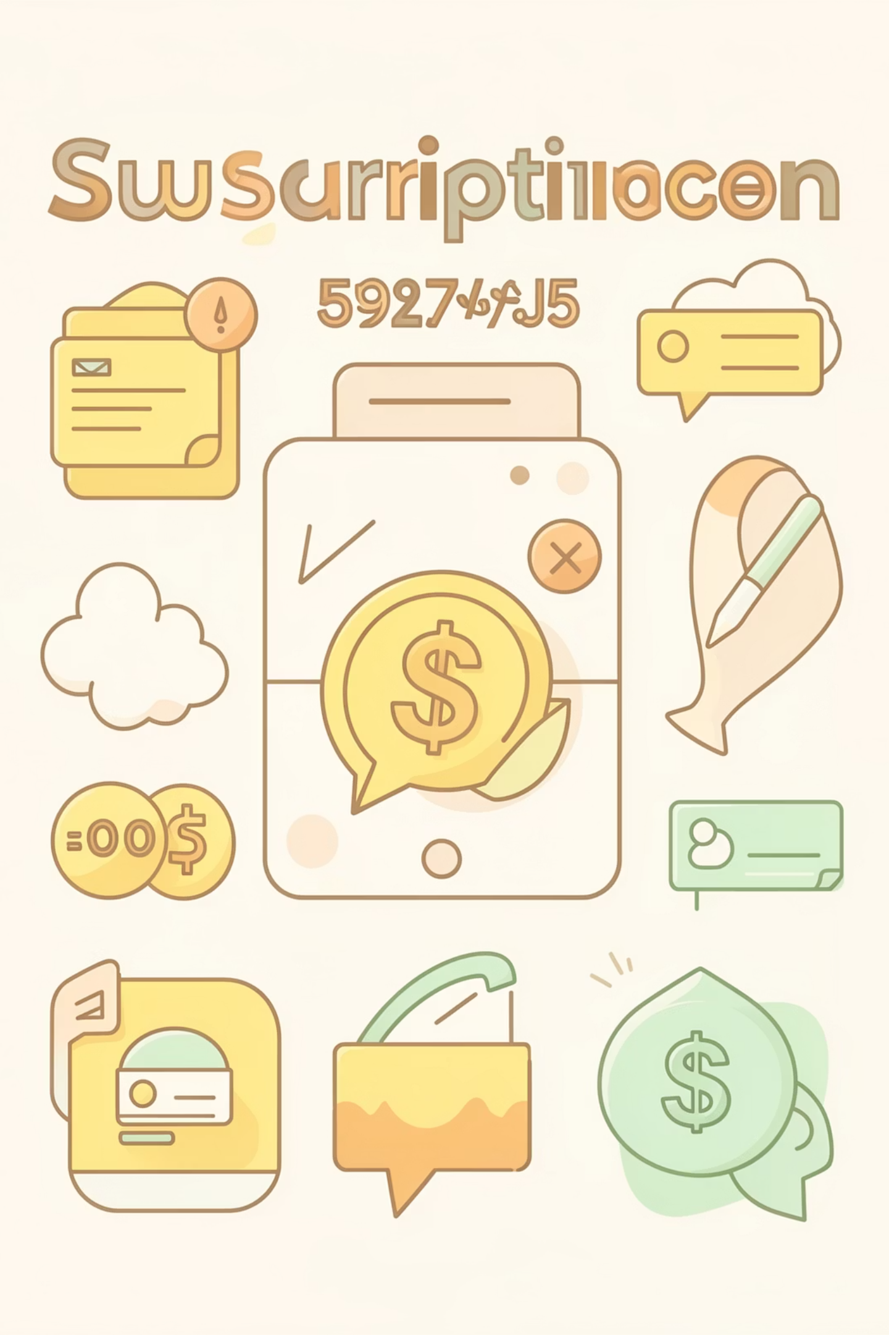
Subscription vs Non-Subscription Behavior
Subscribers
1,053 customers
Avg spend: $59.49
Total revenue: $62,645
Non-Subscribers
2,847 customers
Avg spend: $59.87
Total revenue: $170,436
Only 27% have subscriptions despite similar spending patterns—major growth opportunity

Slide 9



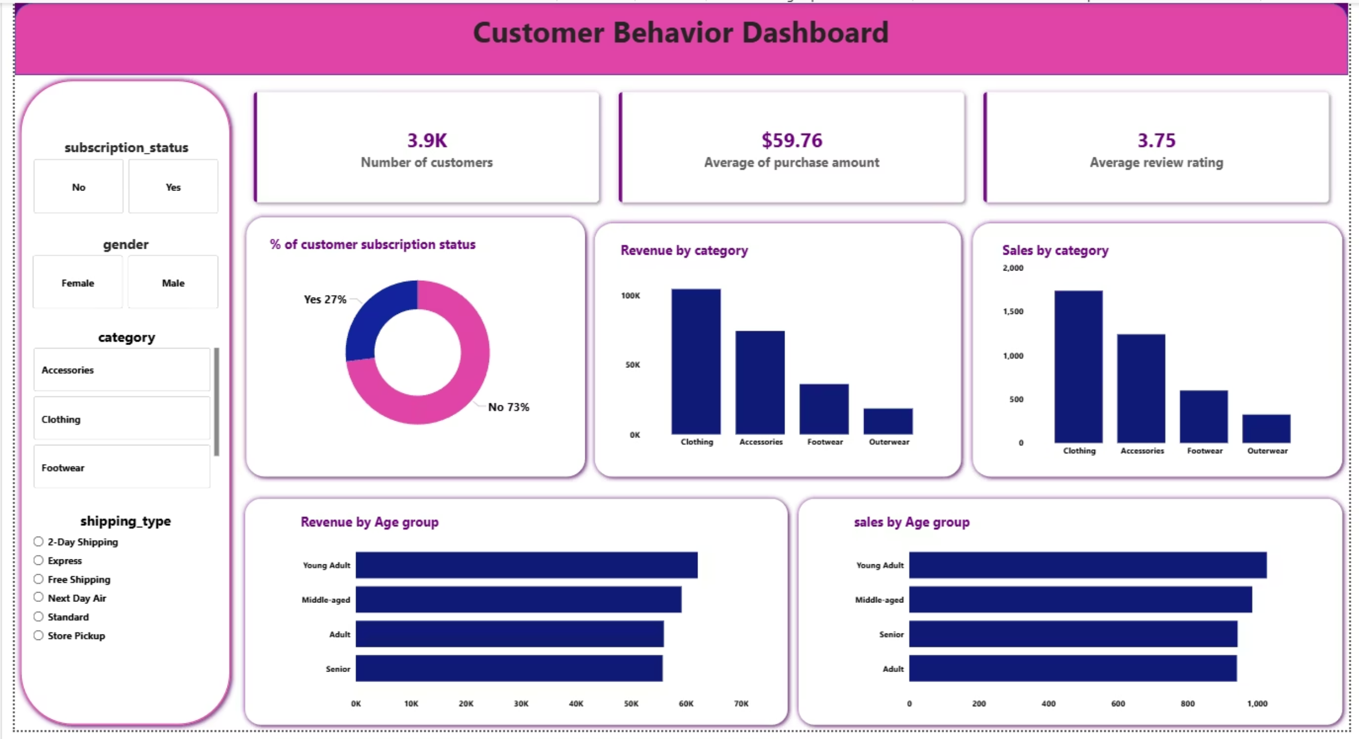
Power BI Dashboard
Interactive Filters
Key Metrics
Visual Analysis
Subscription, gender, category, shipping type
Revenue, customers, purchase value, ratings
Category performance, age groups, demographics
Customer Shopping Behavior Analysis Dashboard

Slide 10
RECOMMENDATIONS
Strategic Actions
01
02
03
Boost Subscriptions
Loyalty Programs
Optimize Discounts
Offer exclusive benefits to increase retention and repeat purchases
Reward frequent buyers to strengthen loyal customer segment
Balance promotional strategy to drive sales while protecting margins
04
05
Product Positioning
Targeted Marketing
Promote top-rated items in marketing campaigns
Focus on high-revenue age groups and express shipping preferences

